Slide 1
Project Presentation
On
DAL-567
“Efficient Steel Surface Defect Detection Using Fine-Tuned Transfer Learning Model with Convolutional Architectures”
Mehta Family School of Data Science and Artificial Intelligence,
Indian Institute of Technology Roorkee
Presentation Date: 25-04-2025
Faculty Advisor
Dr. Abhishek Tiwari
(Associate Professor) Dept. of Metallurgical and Materials Engineering
Presented by Shati Biswas (24565004)
M Tech, (1st), MFS AI
Arpit Kumar Chaudhary (24566006) M Tech (1st), MFS DS

Slide 2
Table of Contents
Introduction
Problem Statement
Data Literature Review & Motivation
Dataset Acquisition and Preprocessing
Methodology, Improvement & Result
Conclusion
Future Scope
Who Will be Benefited

Slide 3
Introduction
Steel surface defects (e.g. scratches, cracks) impact product quality and manufacturing efficiency.
Traditional inspection methods are slow, subjective, and inconsistent.
Deep learning, especially Convolutional Neural Networks (CNNs), enables automated and accurate defect detection.
Transfer learning uses pre-trained models, improving performance even with limited data.
This project fine-tunes advanced CNN architectures for efficient and reliable steel surface defect detection, supporting smarter quality control reduced manual inspection, enhancing quality control efficiency.

Slide 4
Problem Statement
Industrial Context: In steel manufacturing, surface defects such as scratches, patches, and inclusions can significantly compromise product quality, leading to financial losses and potential safety concerns.
Traditional Inspection Challenges: Manual inspection is time-consuming, subjective, and frequent to errors, especially under high-speed production conditions.
Project Objective:
To develop an automated system capable of accurately detecting and classifying steel surface defects using deep learning techniques. | Defect Categories (6 classes): Crazing Inclusion Patches Pitted Surface Rolled-in Scale Scratches

Slide 5
Dataset Literature Review & Motivation
Reference:
Applied Sciences (2019), MDPI – “Periodic Surface Defect Detection in Steel Plates”
Methodology:
Used the dataset with a CNN & LSTM methods.
Results:
Achieved 93.8% accuracy.
Relevance:
Confirms NEU as a reliable benchmark.
Demonstrates transfer learning’s effectiveness in steel defect detection.
Source:
https://www.mdpi.com/2076-3417/9/15/3127

Slide 6
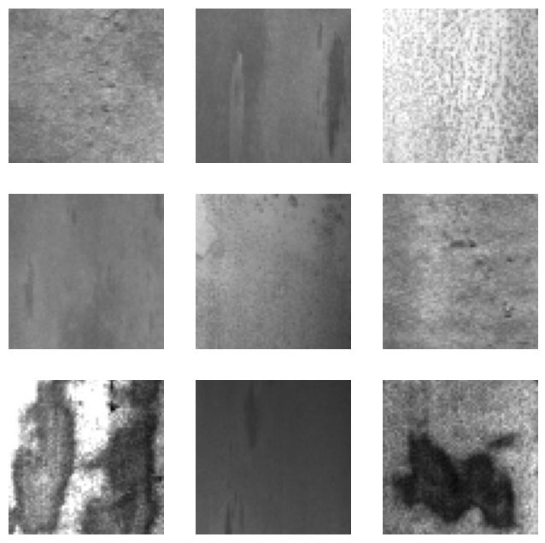
Dataset Acquisition and Preprocessing
Dataset Used: The project utilizes the NEU (Northeastern University) Surface Defect Database, a widely used benchmark dataset for defect detection tasks in the steel industry.
Dataset source:
https://www.kaggle.com/
datasets/kaustubhdikshit
/neu-surface-defect-database
Dataset Composition:
Total Images: 1,800 (300 images per class)
Image Size: 200×200 pixels, grayscale
Format: Pre-labeled with class annotations
Data Preprocessing Method: Image Data
Generator

Slide 7
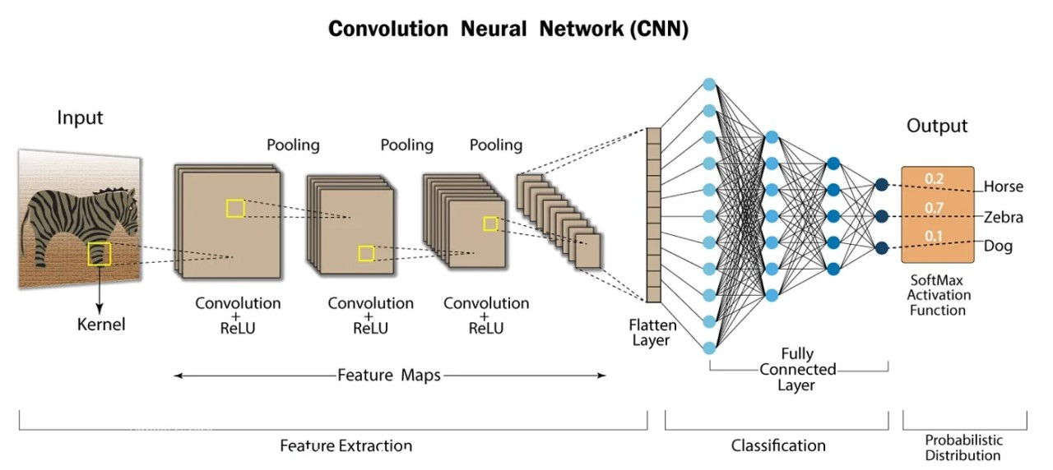
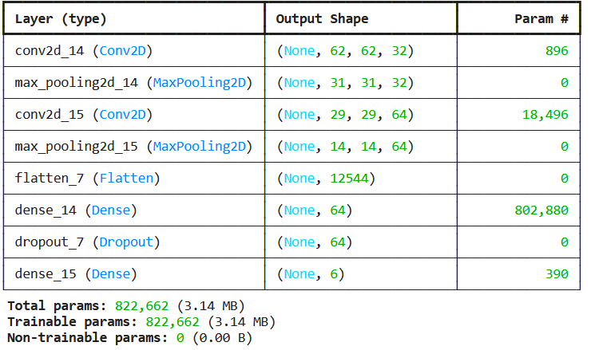
Methodology
Model 1: CNN

Slide 8
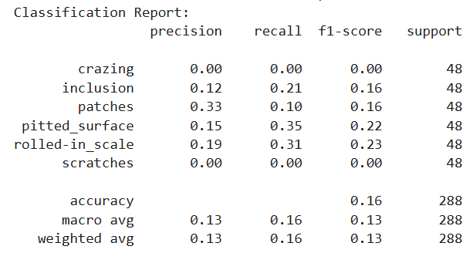
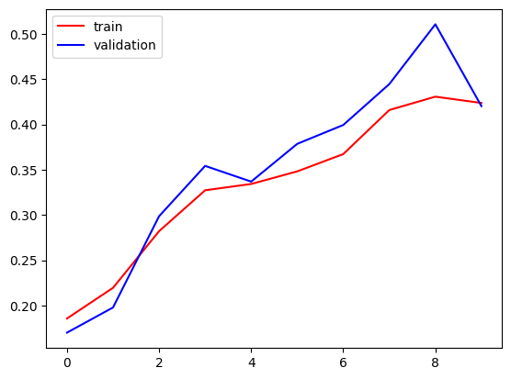
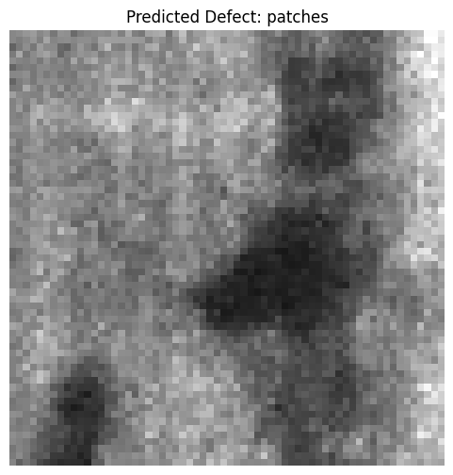
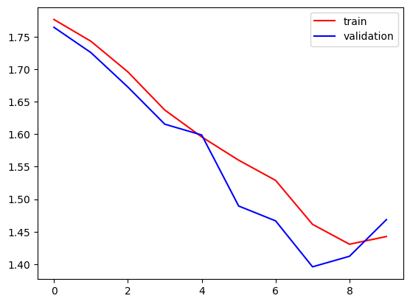
Methodology (Continue….)
Result: Model 1
Probabilities:
crazing: 14.59% inclusion: 10.60% patches: 27.99% pitted_surface: 16.85%
rolled-in_scale: 24.42%
scratches: 5.55%
Validation Loss: 1.4685 Validation Accuracy: 0.4201

Slide 9
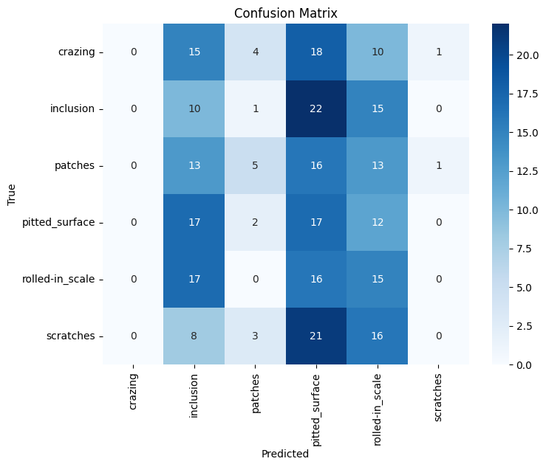
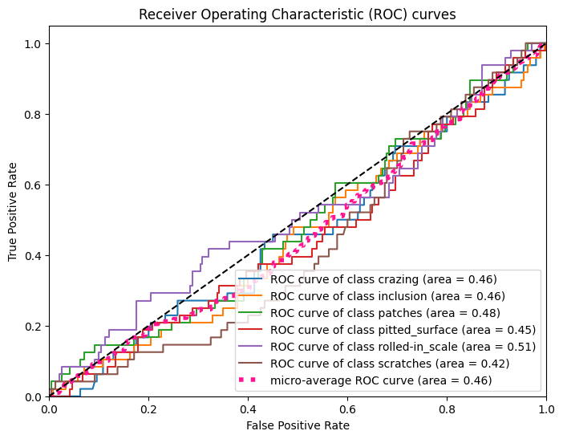
Methodology-model1 (Continue….)
Evaluation:

Slide 10
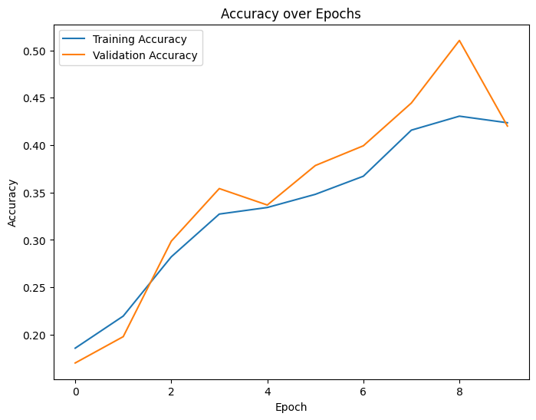
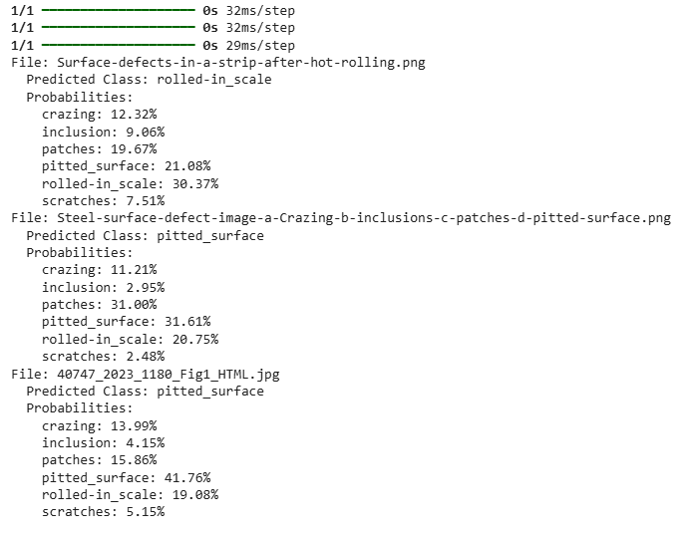
Methodology-model1 (Continue….)
Evaluation:
Check on 3 unseen data(folder):

Slide 11
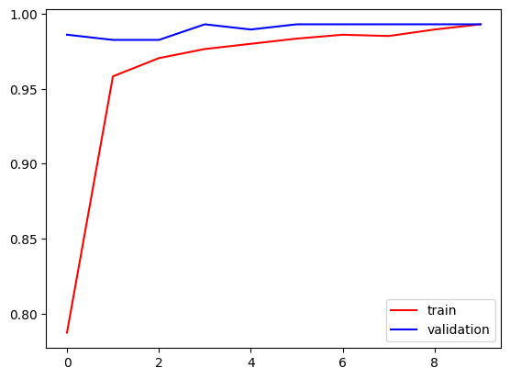
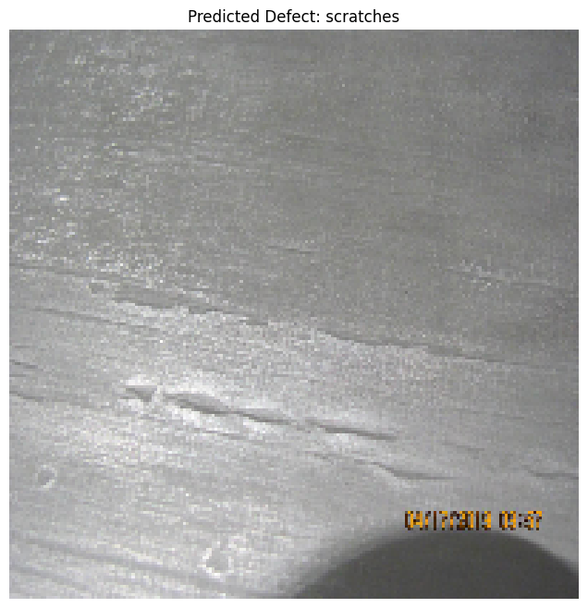
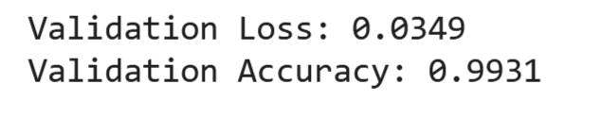
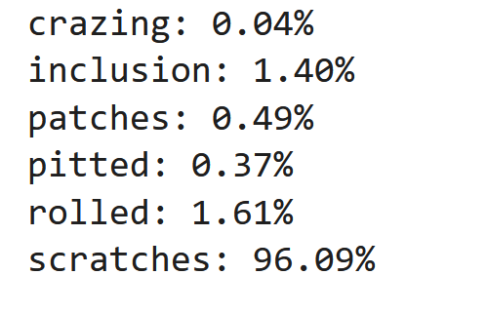
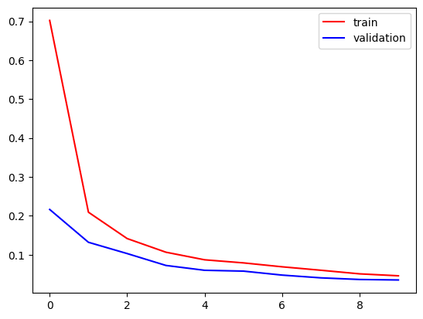
Methodology (Continue….)
Model 2: Improving CNN Model performance with Hyper-parameter Tuning & Transfer Learning
Probabilities:

Slide 12
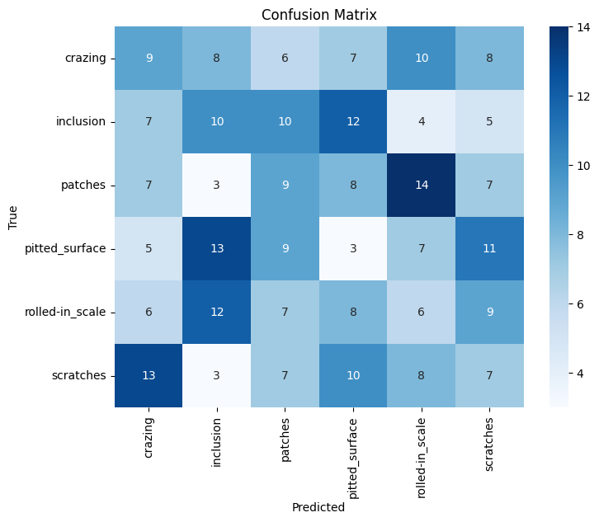
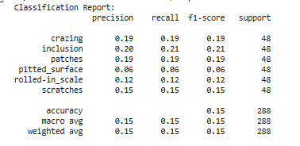
Methodology (Continue….)
Result: Model 2

Slide 13
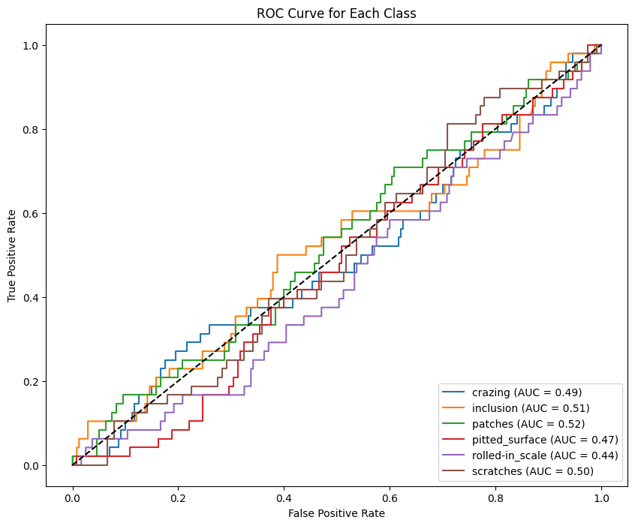
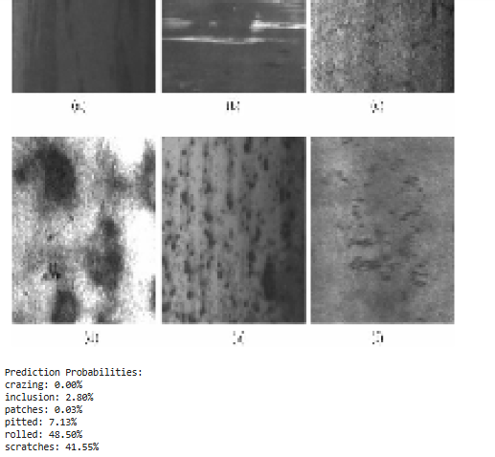
Methodology (Continue….)
Result: Model 2

Slide 14
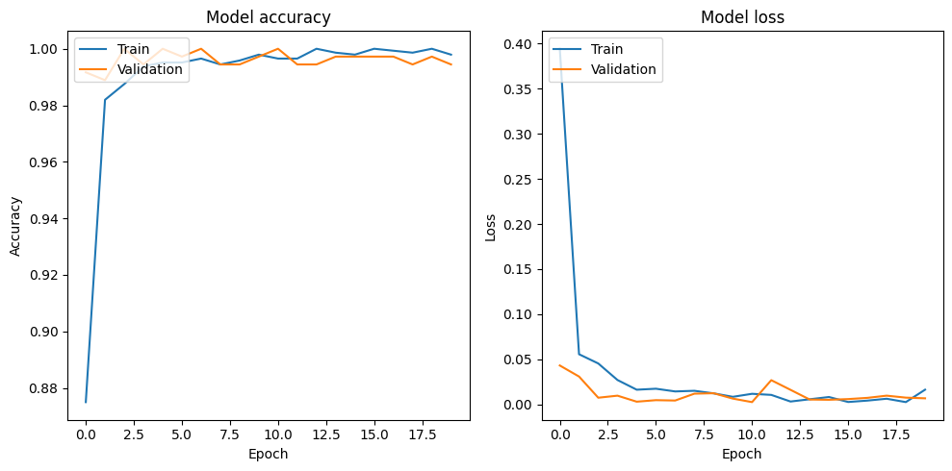
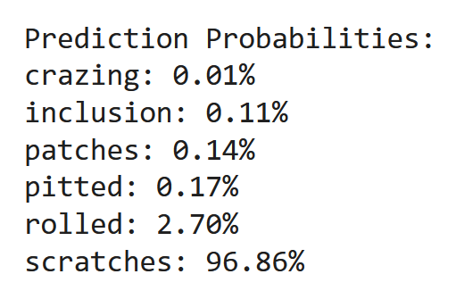
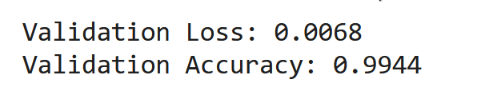
Methodology (Continue….)
Model 3: Compile the model with a learning rate scheduler & fine-tuning.

Slide 15
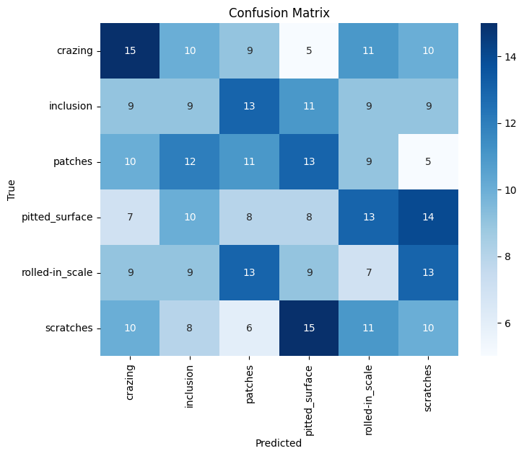
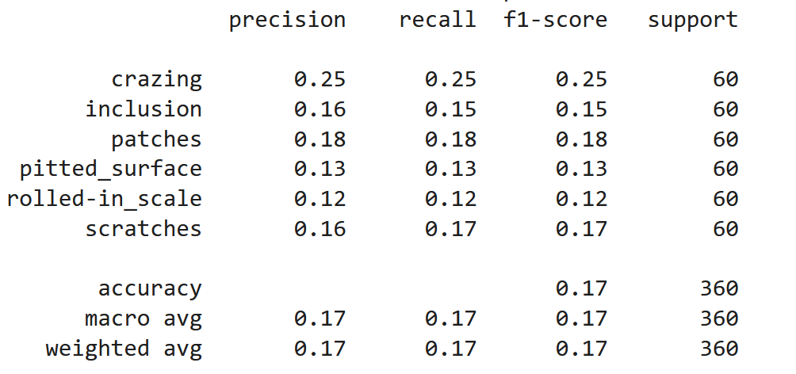
Methodology (Continue….)
Result: Model 3

Slide 16
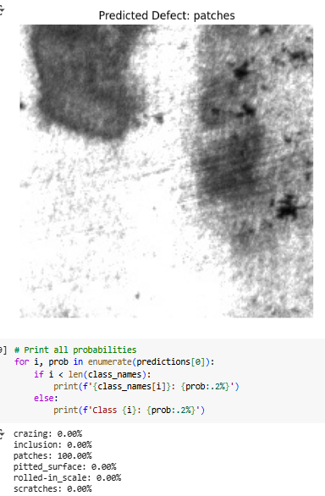
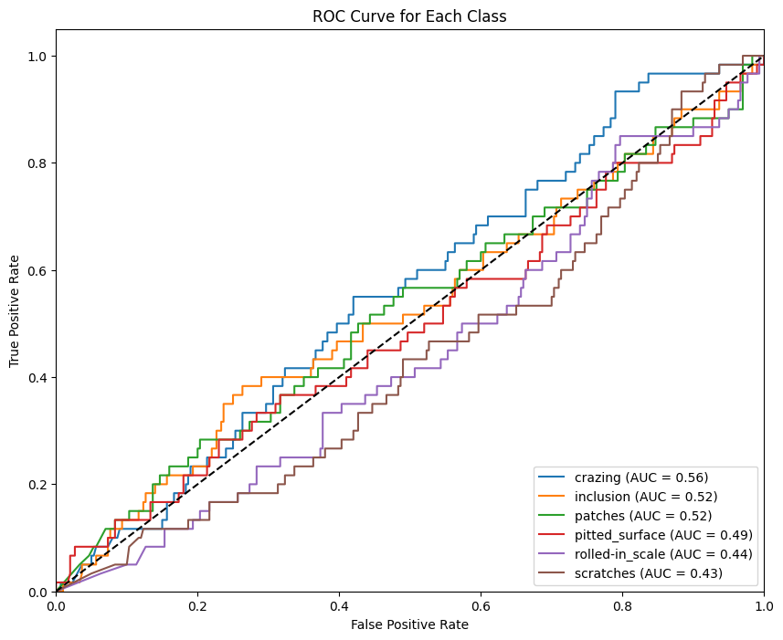
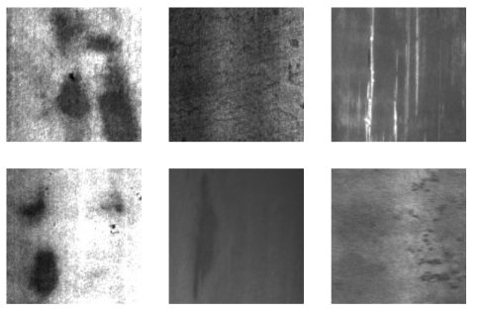
Methodology (Continue….)
Result: Model 3
Class names: ['crazing', 'inclusion', 'patches', 'pitted_surface', 'rolled-in_scale', 'scratches']

Slide 17
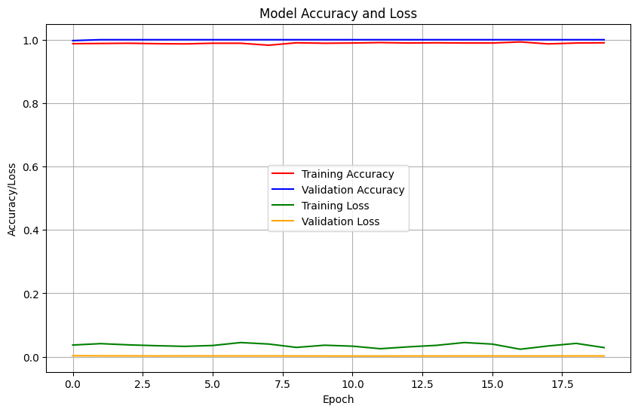
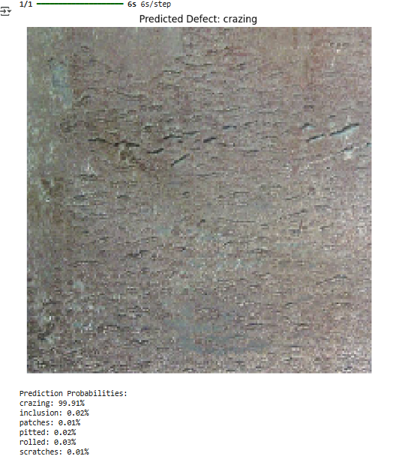
Methodology (Continue….)
Model 4: Model with Data Augmentation.
Probabilities:
Prediction Probabilities: crazing: 99.91% inclusion: 0.02% patches: 0.01% pitted: 0.02% rolled: 0.03% scratches: 0.01%

Slide 18
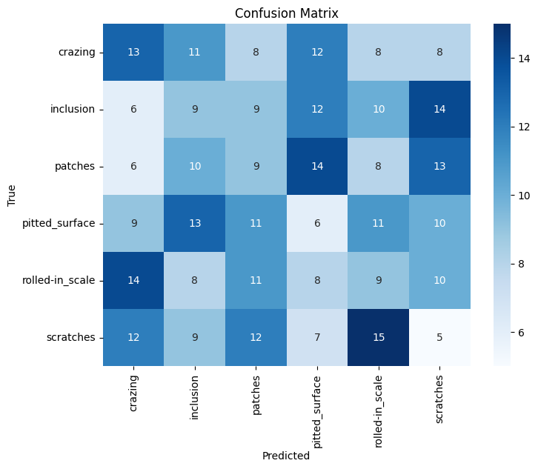
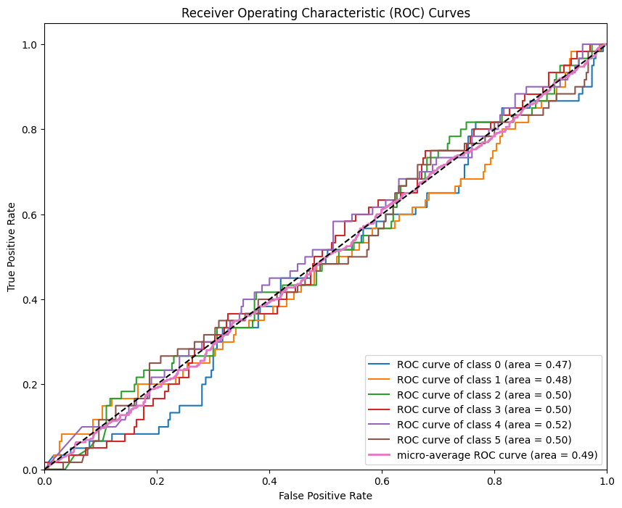
MODEL 4

Slide 19
Conclusion
In this project, we successfully implemented a deep learning-based approach for detecting steel surface defects using transfer learning.
The use of a pre-trained ResNet50V2 model, fine-tuned on the NEU dataset, provided high classification accuracy across six defect categories.
Data augmentation techniques were employed to enhance model robustness and improve generalization by simulating variations in defect appearance. All in all,
Developed an automated steel surface defect detection system using deep learning on the NEU dataset (1,800 images). Improved baseline CNN accuracy (42%) to ~99% via transfer learning, fine-tuned ResNet50V2, and augmentation, enabling robust, real-time quality control in manufacturing.

Slide 20
Future Aspects
Model Enhancement: Integration of more advanced architectures like Vision Transformers or EfficientNet.
Real-Time Detection: Deploying models on edge devices for real-time surface inspection on production lines.
Generalization: Training on larger and more diverse datasets for improved cross-industry performance.
Automation Integration: Linking defect detection directly with quality control systems to automate corrective actions.

Slide 21
Who will be Benefited
Steel Manufacturing Units: Early and accurate detection reduces material waste and improves quality.
Quality Control Engineers: Helps in automated reporting and reduces manual inspection workload.
AI Researchers: A benchmark for experimenting with novel deep learning architectures on industrial data.
Industrial IoT Companies: Scope to integrate with smart factories and predictive maintenance platforms.

Slide 22
Thank You

